Slide 1
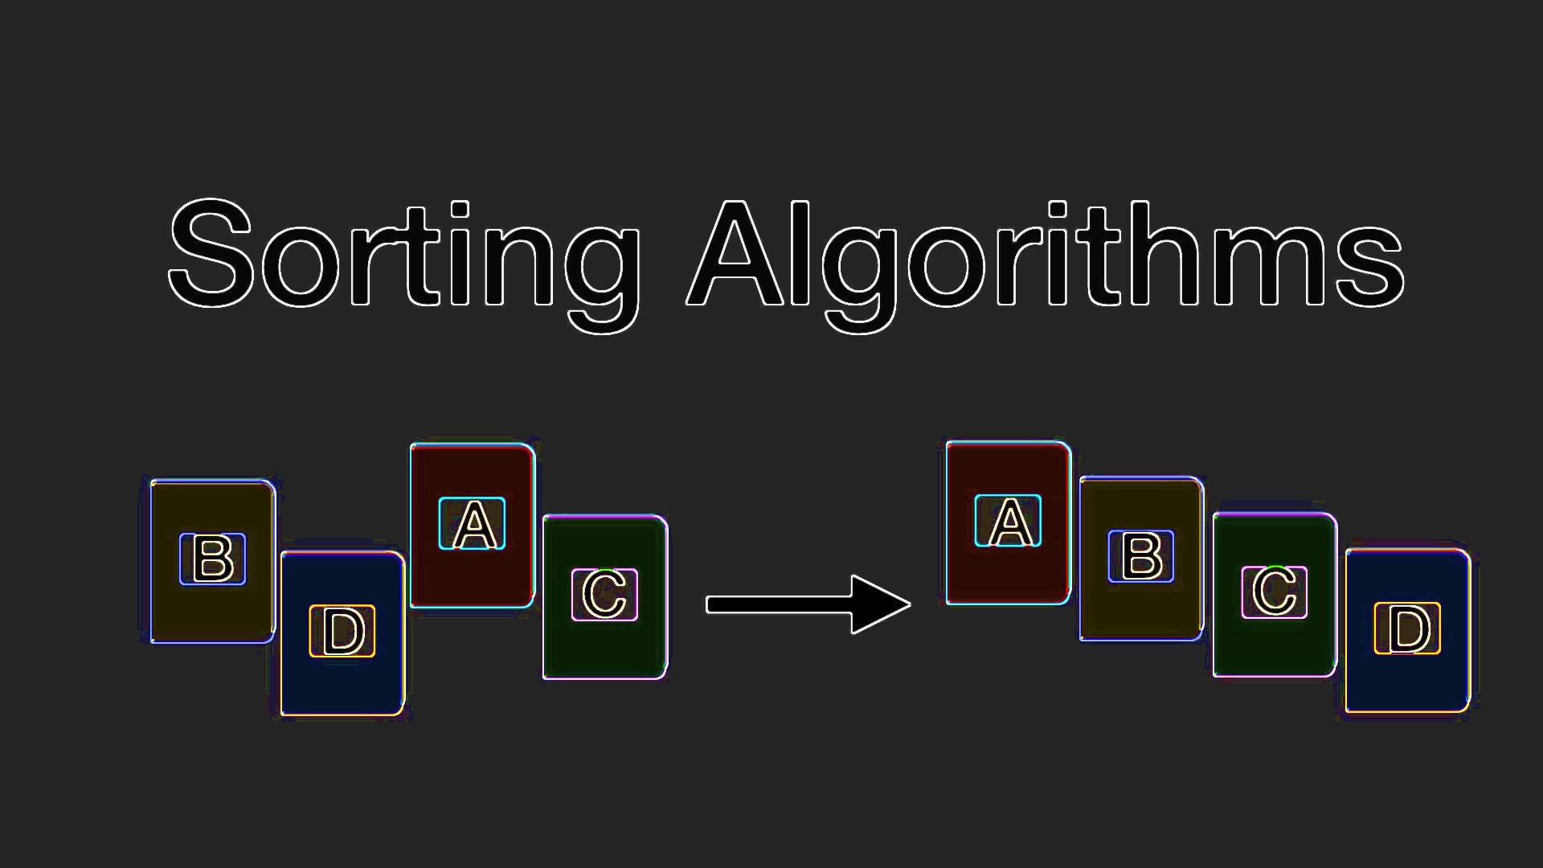
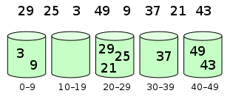
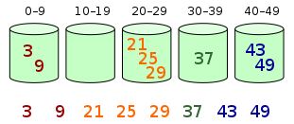
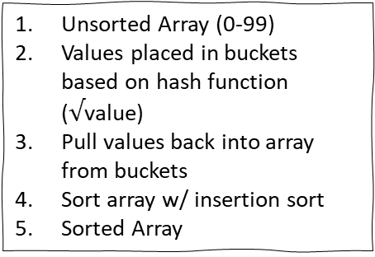
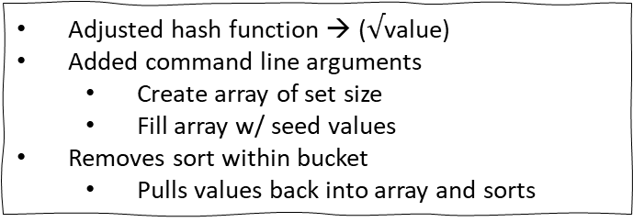
Bucket Sort Algorithm
Tim Sprunger & Landon Baer | CS325 | December 6, 2019
What Is It?
Modifications
New Algorithm
A Bucket Sort is a comparison sort algorithm that sorts values by dividing them into various buckets and then sorting the individual buckets.
Adjusted hash function → ($√$value)
Added command line arguments
Create array of set size
Fill array w/ seed values
Removes sort within bucket
Pulls values back into array and sorts
Unsorted Array (0-99)
Values placed in buckets based on hash function ($√$value)
Pull values back into array from buckets
Sort array w/ insertion sort
Sorted Array
Order of Magnitude
O(N) – but is known to have faster sorting compared to other O(N) algorithms.
Things to Note
How It Works
Sq. root hash was a more effective way of placing values in bucket. So, values were more sorted early on
Expand value range by adding more buckets
Radix Sort vs Bucket Sort
LSD → MSD
MSD → LSD
Unsorted Array (0-99)
Values placed in buckets based on hash function (i.e. value/10)
Sort values within buckets w/ insertion sort
Pull values back into array from buckets (in sequence)
Sorted Array
Notes:
bucketSort Demo
cd Downloads/BucketSort/
javac BucketSort.java
java BucketSort
java BucketSort 9 1
java BucketSort 11 10

